Slide 1
Weekly report: Machine Bed & Yaw System
Week No - 6
Date: 04.11.2025
Supervisor: Prof. Peter Quell
Shoukat Abbas, Luksh Chawla, Sathishkumar Venkatachalam, Shrihari G Kadam
Presented by – Luksh Chawla

Slide 2
Contents
Number of Yaw Drives Calculation
Number of Yaw Drives – Syria
Yaw Bearing type
Machine Bed 2D sketching with proper Dimensions
References
Luksh Chawla

Slide 3
Number of Yaw Drives Calculation
Bonfiglioli 716 T4 drive (suggestion).
Assumptions:
Pitch circle diameter of yaw bearing PCD Bearing(Syria) =3800 𝑚𝑚
Nominal torque: 90 kNm
Pitch circle diameter of pinion PCD Pinion=288 𝑚𝑚
Operational yaw moment Mz,op(Syria)= 7164 kNm
Pinion module= 24
Pinion teeth number = PCDpin/Pinion module=288/24=12
Luksh Chawla

Slide 4
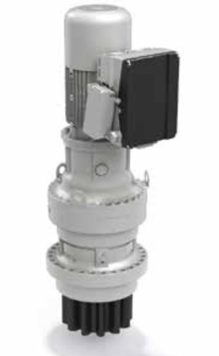
Number of Yaw Drives – Syria
Bearing teeth number =(PCDbearing)/ Bearing module =3800/24 = 158.33
rounded to 158.
The external gear ratio (iex)
PCD Bearing = Bearing module × Bearing teeth number = 24 × 158 = 3792mm
iex = PCDBearing /PCDPinion=3792/288 = 13.16
The number of yaw drives (N) is determined using the following formula:
N=Total yaw moment/Each drive nominal torque × iex
N =7164/90 × 13.16 = 6.04
rounded up to 6 no of yaw drives
Source: Bonfiglioli 716 T4F + BE160 + DGM Inverter [1]
Luksh Chawla

Slide 5
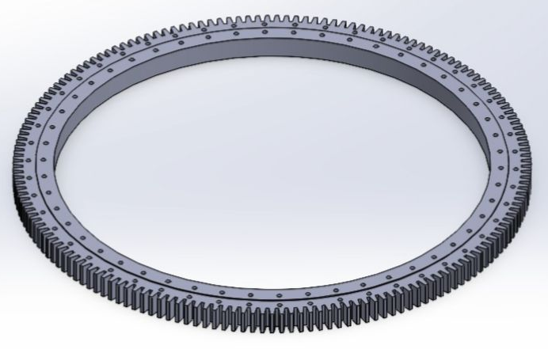
Yaw Bearing (Double-row 4-point Bearing)
Advantages –
Matches a larger tower-top geometry
High tilting moments for future load revisions
Sized for high loads
Conservative margin & system integration
Disadvantages –
Approximate and needs vendor verification
Higher cost/lead time and potential custom work
Upscaling by section modulus is approximate
Thyssenkrupp Double-row four-point yaw bearings (Series 09) [2]
Luksh Chawla

Slide 6
Double row 4 - Point Bearing (External Gearing)
Why does this choice fit Optimus Syria?
Tower-top diameter is 3.8 m (very close to Shakti’s final ~4.0 m PCD choice).
Similar interface and allows standard gear teeth dimensions/pinion geometry
Tilting moments are likely closer to Shakti’s loads
Double row four-point slewing bearing with external gearing (ThyssenKrupp style)
Sized close to the tower top / pitch-circle diameter (PCD)
Luksh Chawla

Slide 7
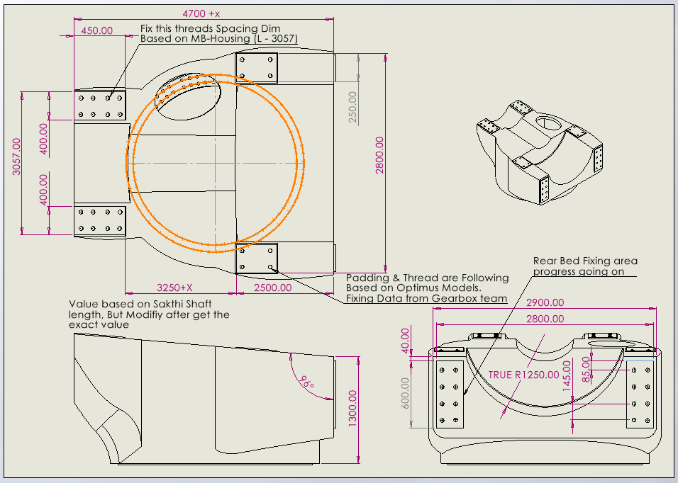
Bed Casting - 2D Dimension Defined
Note: For Defining of Dimension, we utilize Optimus 92LE Concept 2D drawing. [3]
Luksh Chawla

Slide 8
Bed Casting - Updation
1. Shaft Dimension - Looking for the proper dim. values of a shaft to fix the total length of the bed.
2. Yaw drives & Bearing - As per the calculation, we are going to use 6 yaw drives. Bed design update in progress.
3. Main Bearing and Gearbox Fixing Details Needed.
4. 3D Model on process - Reference Senvion MM92
Luksh Chawla

Slide 9
References
[1]. Bonfiglioli (accessed 19 Oct 2025). Solutions for Wind. https://www.bonfiglioli.com/_default_upload_bucket/TR_CAT_WIND_STD_ENG_R05_0.pdf
[2]. WEC Development Project: Optimus Shakti 5.0 Machine Bed and Yaw System Final Report.
[3]. Master Wind Engineering Project Optimus 92LE Machine Bed and Yaw System
Luksh Chawla

